Slide 1

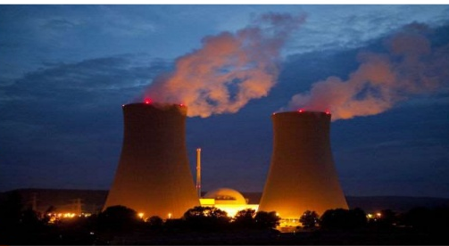
(Management Topic in Environmental Studies) B. Tech 7TH Semester
Ecosystem
Prepared by; Dr Naresh Kumar Sahoo
Department: Chemistry
Subject: MTES (CHM 2049)

Slide 2
Topic to be discussed
Introduction
Types of ecosystem
Structure of ecosystem
Function of ecosystem
Food chain and Food web
Energy flow in a ecosystem
Primary production and secondary production
Ecological Pyramids
Nutrient flow, Nitrogen cycle, carbon cycle, hydrological cycle

Slide 3
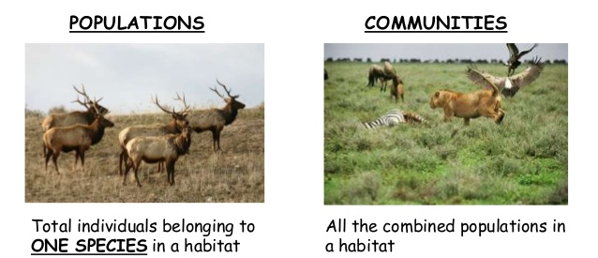
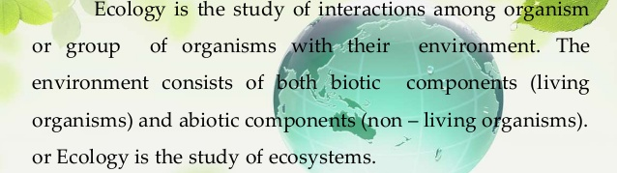
Ecology
The term Ecology was coined by Earnst Haeckel in 1869.
It is derived from the Greek words Oikos- home + logos- study. So ecology deals with the study of organisms in their natural home and interacting with their surroundings
According to Tansley (1935): An ecosystem is a group of biotic communities of species interacting with one another and with their non-living environment exchanging energy and matter.

Slide 4
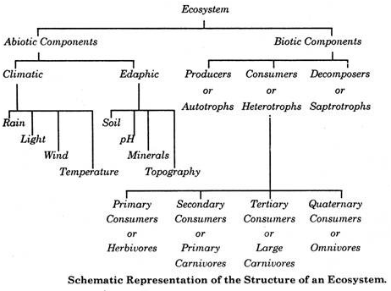
Structure of Ecosystem
Non-Living components
Living components
Macro-consumer
Micro-consumer
3. Lithosphere
Plant
1. Atmosphere 2. Hydrosphere
Parasite,
Malaria parasite
Organic & inorganic
Protein, fat, carbohydrate
Minerals
Cow, elephant, deer
Cockroach, Human
1st tropic level
Frog, Dog, Cat, Jackal
Lion, Tiger, Hawk
4th tropic level
2nd tropic level
3rd tropic level

Slide 5
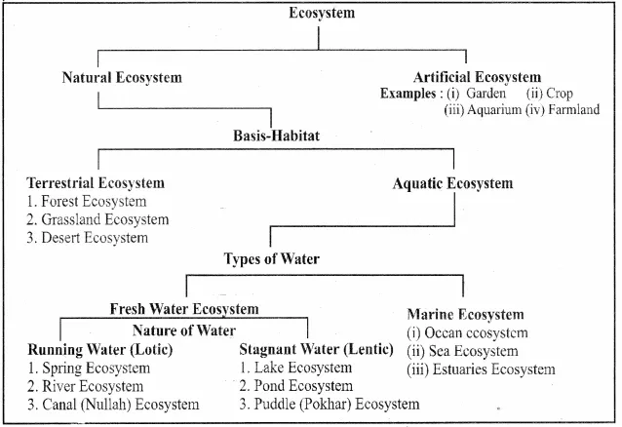
Types of Ecosystem

Slide 6
Function of Ecosystem
The major functional of ecosystems are as follows:
(i)Primary function: Photosynthesis
ii) Secondary function: Transfer of energy (Energy flow) to all consumer
Iii) Tertiary function: Food chain, food webs and trophic structure
(ii) Nutrients flow (Biogeochemical cycles)
(iii) Primary and Secondary production
(iv) Ecosystem development and regulation
(v) Control species gradient
(vi) Pollution control such as CO2 by plant, Nitrogen fixation by Rhizobium bacteria

Slide 7
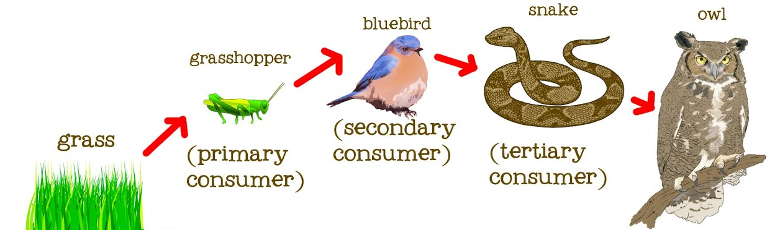
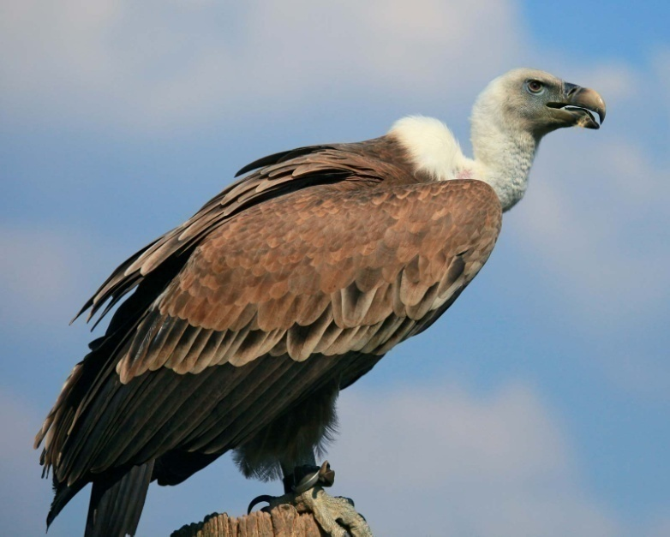
Food Chains
Food chain: Transfer of food energy/ chemical energy from producer/plant to higher
successive tropic level by eating and being eaten.

Slide 8
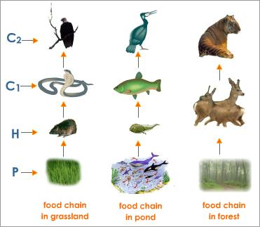
Types of Food Chains
Types of Food Chain
i) Grazing/ predator food chain: Food chain Start with grazing or killing as shown in figure
Small fish
Zooplankton
Phytoplankton

Slide 9
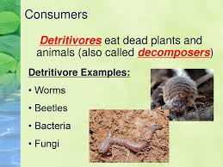
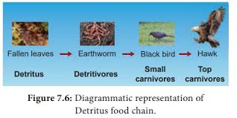
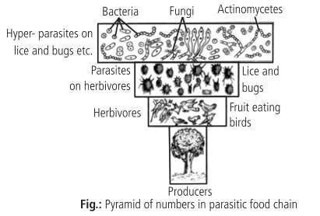
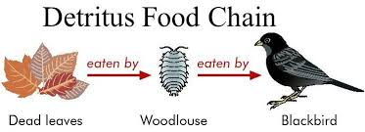
Types of Food Chains
ii) Detritus Food chain: Start with dead and decaying material
iii) Parasitic Food Chain: Parasite is taking food from living host
Plant
Fruit eating bird
Lice and Bug
Bacteria/ Fungi

Slide 10

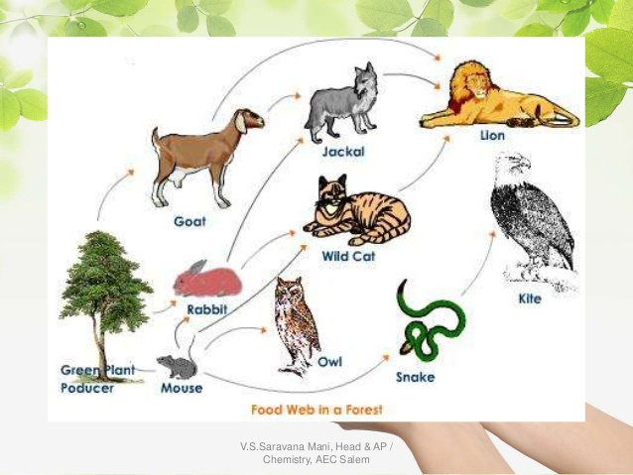


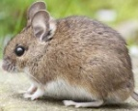


Food web
Food web: The interconnection of different types of food chain in a ecosystem by different types of organisms at different tropic levels, forming a web like structure collected Food web. Where different types of organisms are connected at different tropic levels
Eagle
Cat
Snake
Bird
Rabbit
Mouse
Frog
Insect
Grass hopper

Slide 11
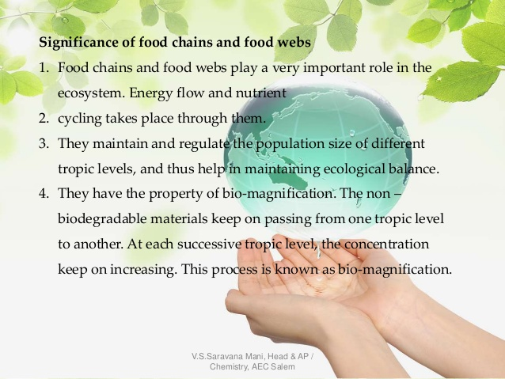
Significant of Food chains and Food webs

Slide 12
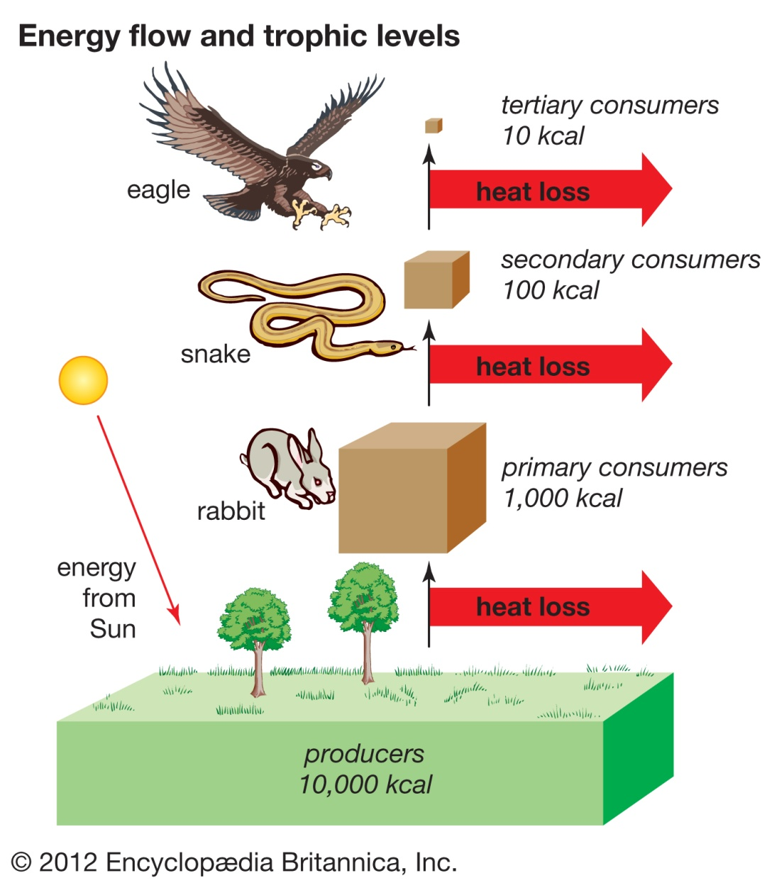

Energy flow in a Ecosystem
4. Some food energy stored in consumer system & plant (excretory Material ) move to (flow) decomposer bacteria and stop the flow of energy
3. Some food energy is utilized for metabolism of food
material in the consumer system called respiratory
Energy
Respiration
Dead body
Excretory material
2. Plants biochemical energy (Food energy) consume by primary, 2ndary and tertiary consumer where food energy converted
To mechanical energy, heat energy, sound energy, potential energy etc energy
Follow 2nd low of thermodynamic
Each step 90% energy loss in the form of heat, sound, respiration energy
Respiration
Decomposer bacteria
Dead body
Excretory material
Respiration
Dead body
Excretory material
1. Solar radiation energy trap by plant and in photosynthesis
and converted to biochemical energy (Food energy)
Follow 1st low of thermodynamic
Energy flow is unidirectional but nutrient flow is cyclic

Slide 13
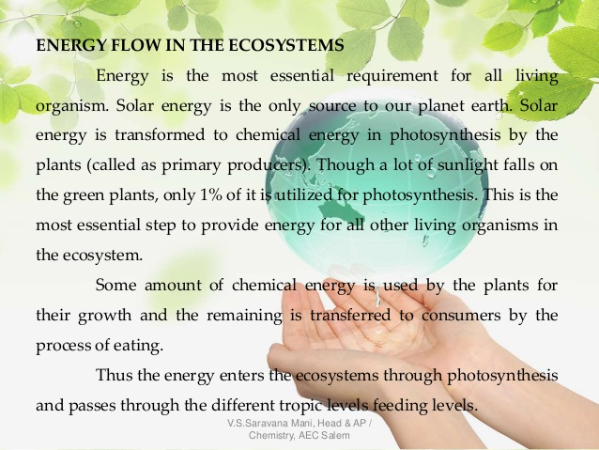
Energy Flow

Slide 14
Primary production
Primary productivity: The rate at which radiant energy (light energy) is converted into chemical energy and stored in a plant by photosynthesis process per unit area per unit time called Gross Primary Production (GPP)
Respiration energy: When organic matter is produced by the primary producers (mainly green plants and some microorganisms), fraction of chemical energy is oxidized or used in the metabolic process of photosynthesis inside their body and converted into carbon-dioxide which is released during respiration called respiration energy and is accompanied by loss of energy. (R)
Thus Net Primary Production (NPP) = Gross Primary Production (GPP) – Respiratory energy (R).
NPP = GPP -R
Secondary Production: The energy stored at consumer level for use by the next trophic level is thus defined as secondary production

Slide 15
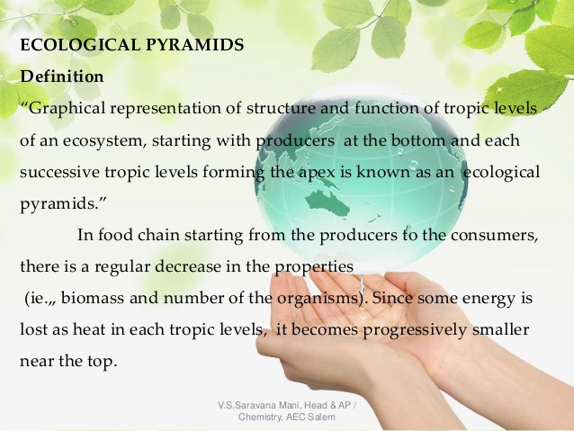
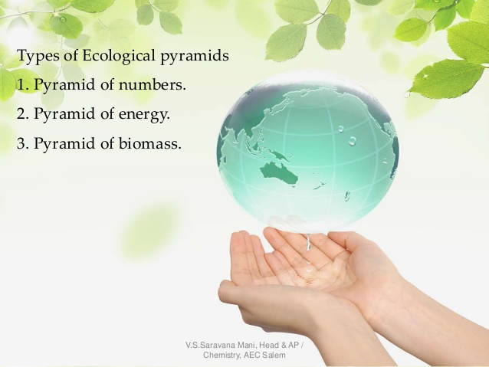
Ecological Pyramids

Slide 16
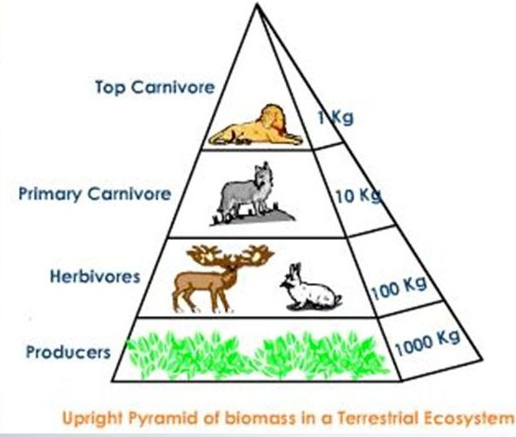
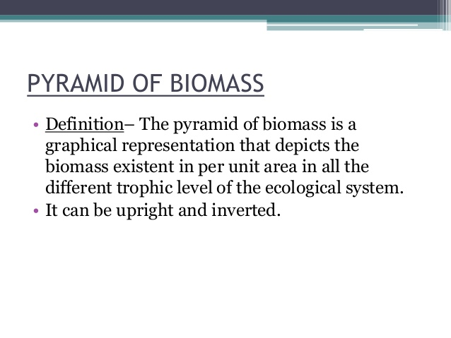
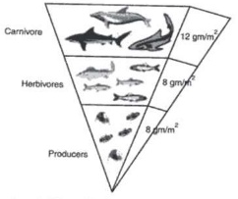
Pyramids of Biomass
UPRIGHT PYRAMID
Phytoplankton
INVERTED PYRAMID
A pyramid of biomass shows the weight of biomass/organism
At stages of food chain
A pyramid of biomass in aquatic system

Slide 17
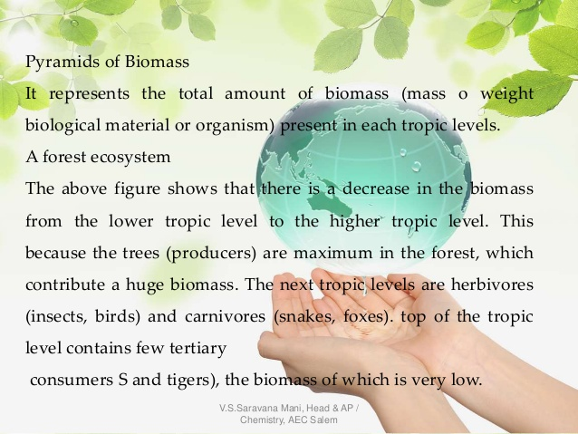
Pyramid of Biomass

Slide 18
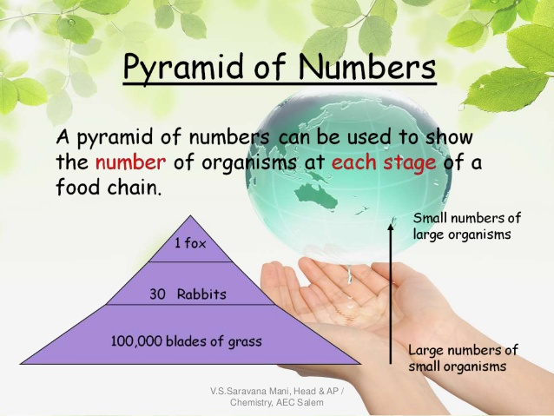
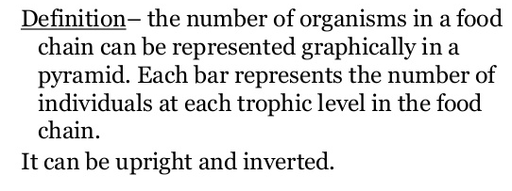
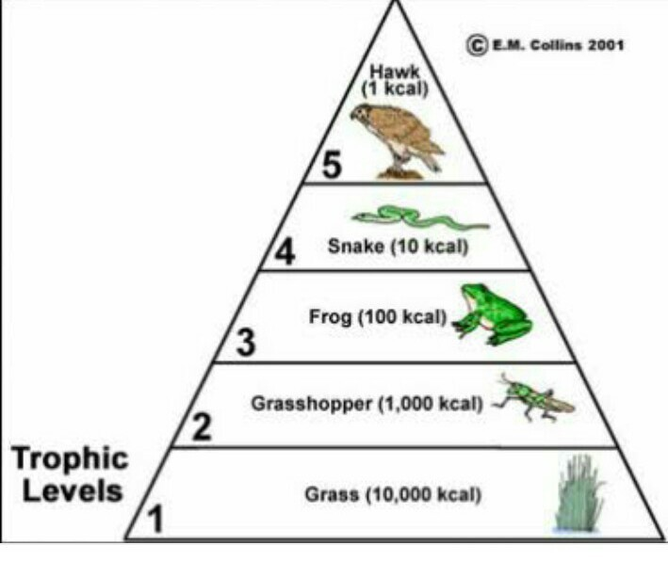
Pyramid of Number
UPRIGHT PYRAMID
INVERTED PYRAMID
Pyramid of Number in grass land ecosystem

Slide 19
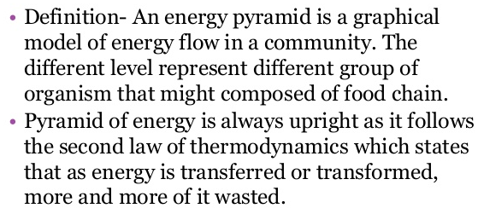
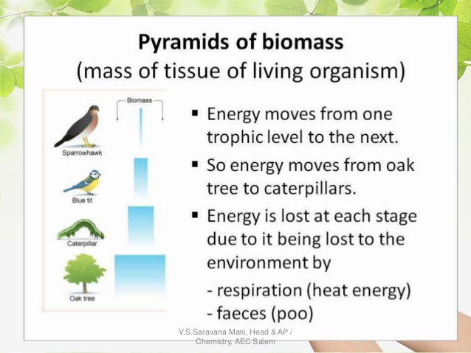
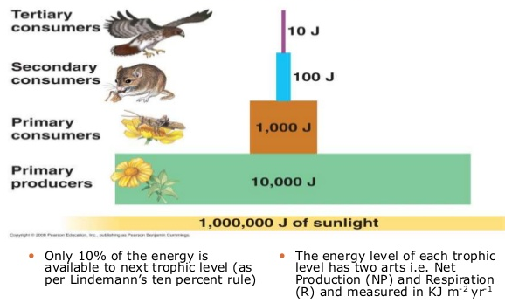
Pyramid of Energy
Transferred to other form

Slide 20
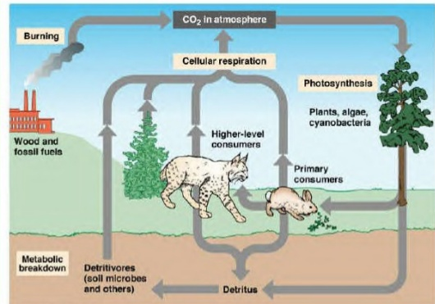
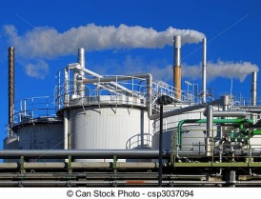
Carbon cycle
Cyclic movement of carbon from biosphere through lithosphere,
hydrosphere and atmosphere called carbon cycle
CO2
Natural calamity
earth quake
Buried deep in to earth with
high temp, & pressure formed
Coal , petrol and diesel etc

Slide 21
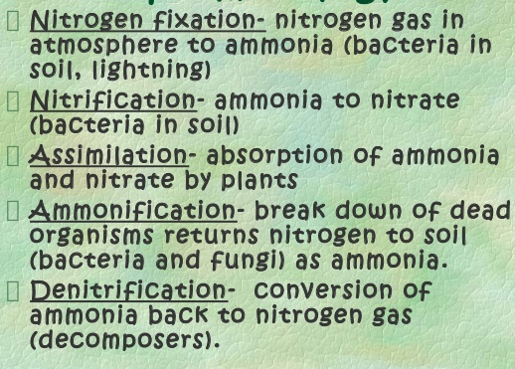
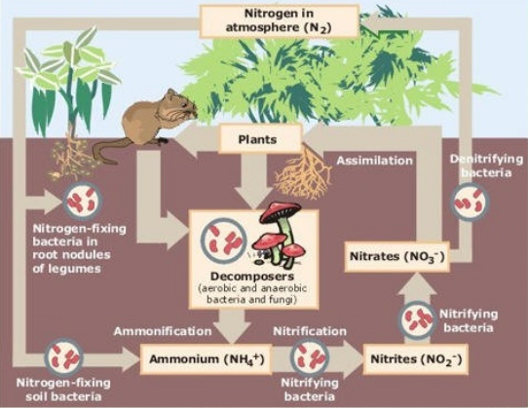
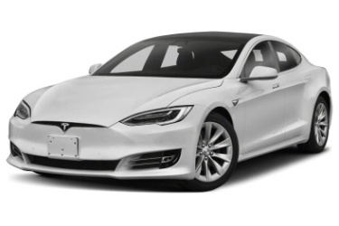
Nitrogen cycle
HNO3 acid rain
1⁰,2⁰,3⁰ consumer
Biosphere
NOx
Fossil fuel etc
Lithosphere, hydrosphere, Biosphere, Industrial Nitrogen fixation

Slide 22
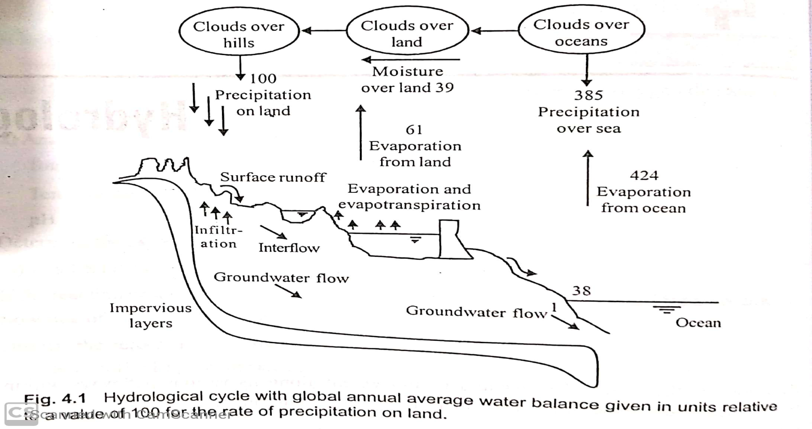
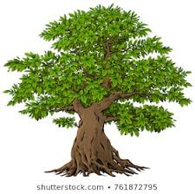
Hydrological cycle
Evaporation
Evaporation
Precipitation
Precipitation
G
Transpiration
Glacier / Snow
Glacier melting

Slide 23


